Slide 1
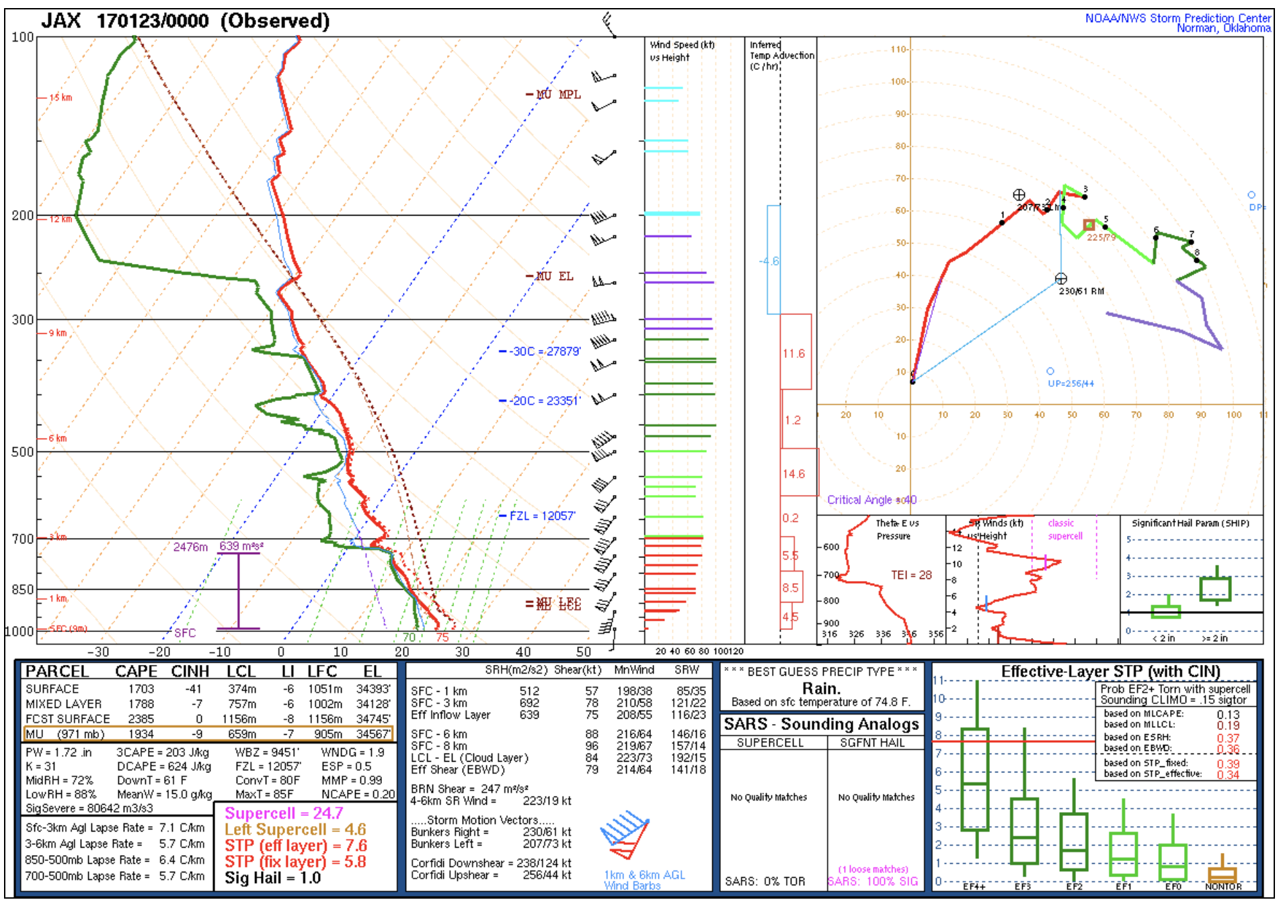
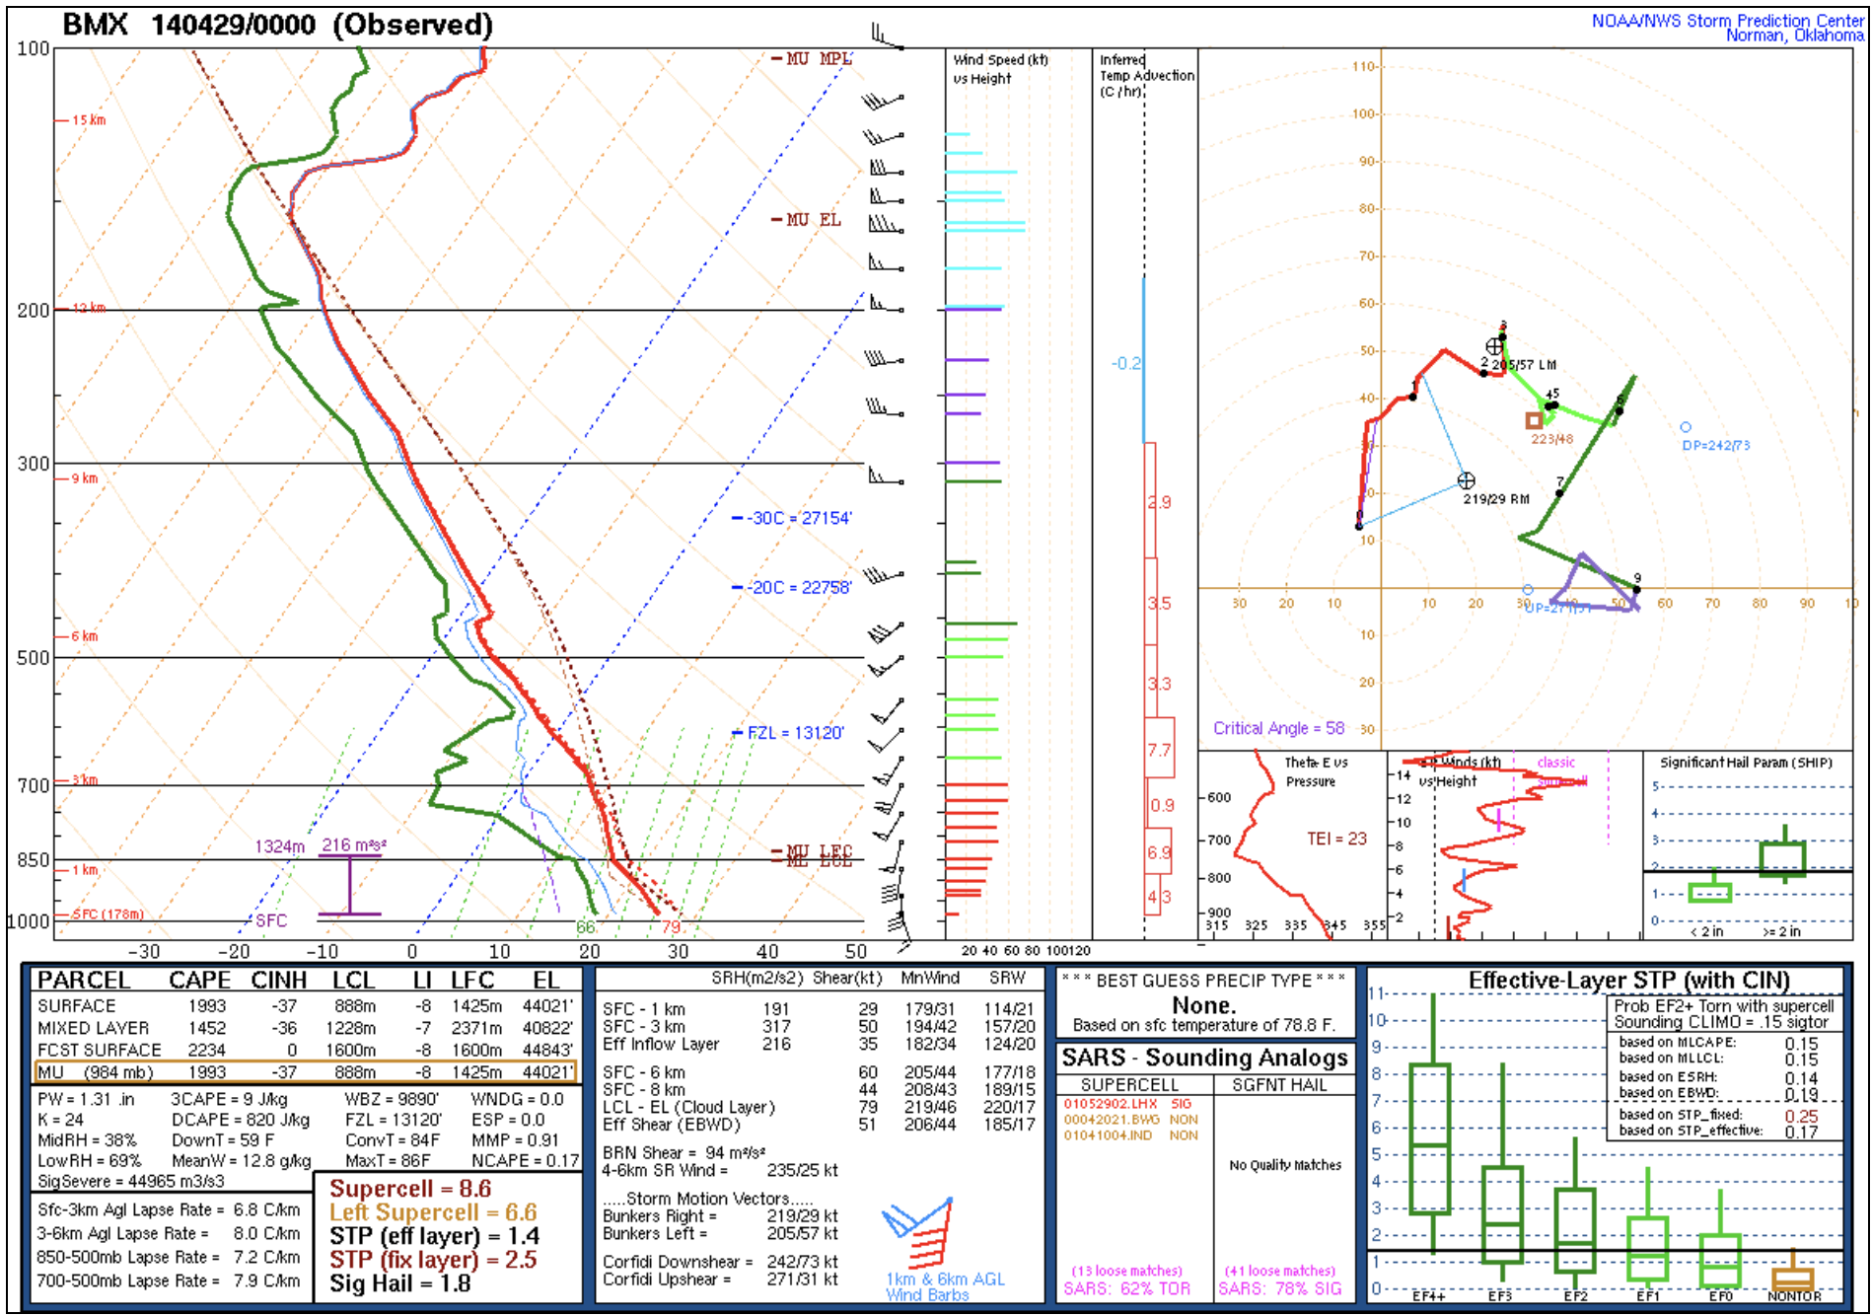
POP QUIZ

Slide 2
One of these soundings is associated with a 150+ tornado outbreak.
Which one?

Slide 3
A
B

Slide 4
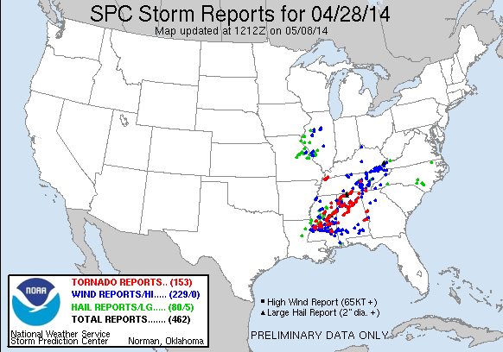
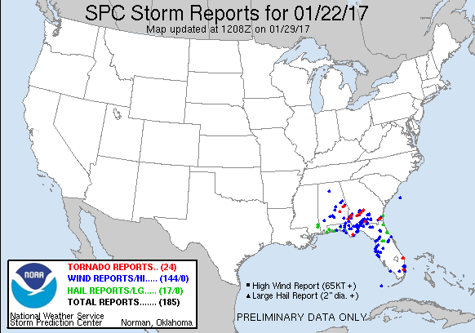
A
B

Slide 5
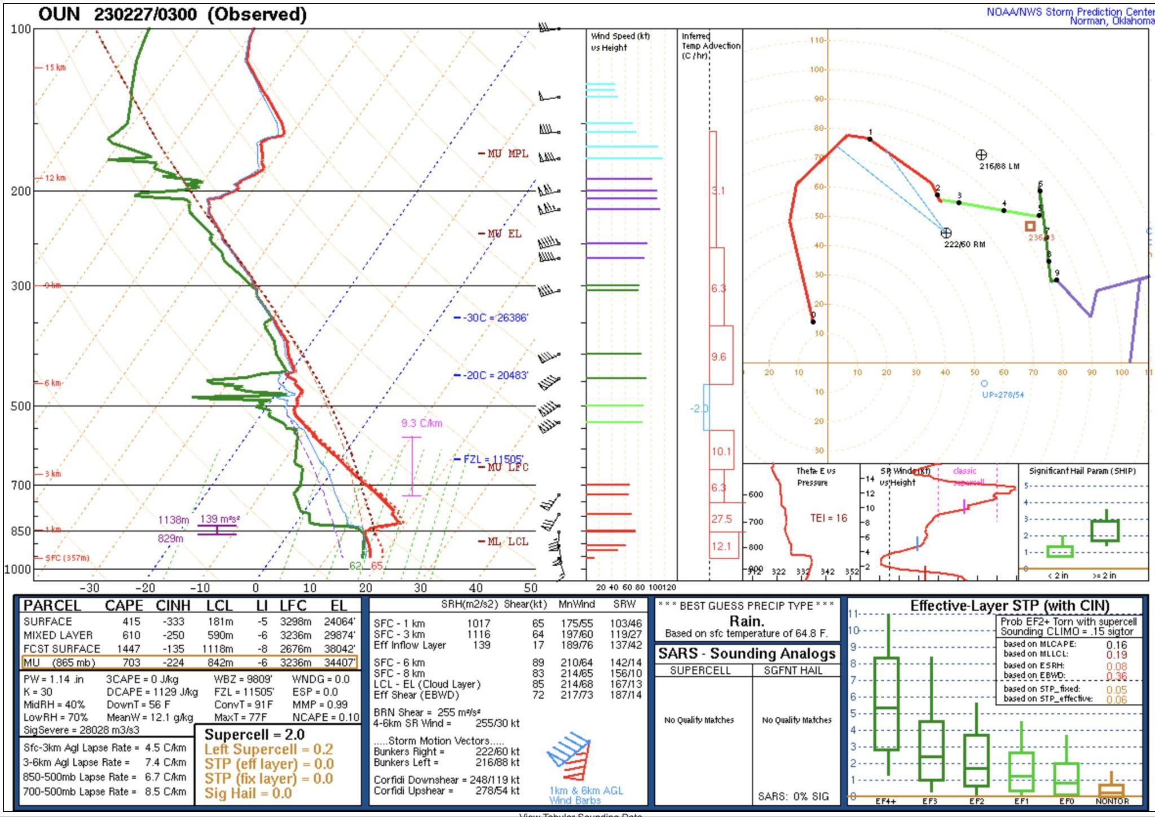
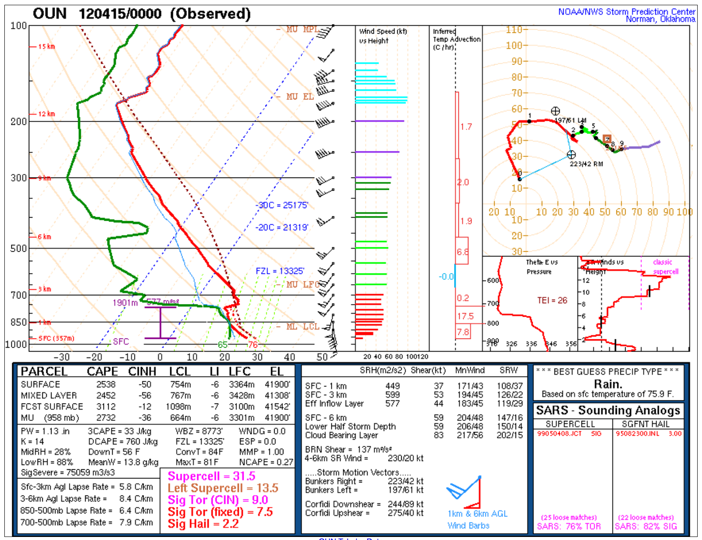
A
B
One of these soundings is a proximity sounding to an EF-2 tornado.
Which one is it?

Slide 6
A
B

Slide 7
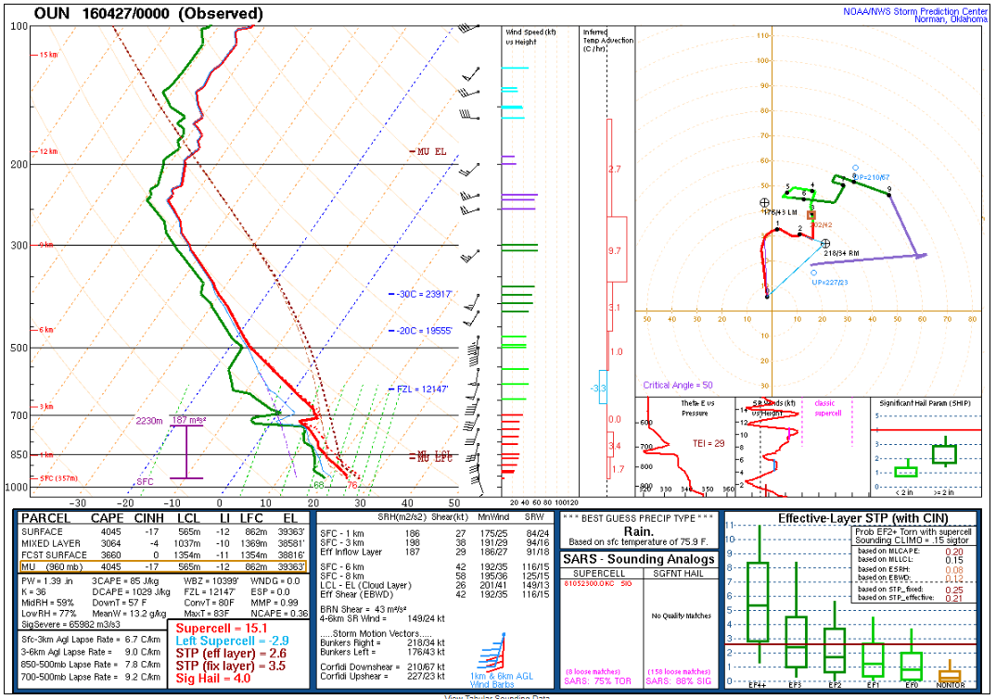
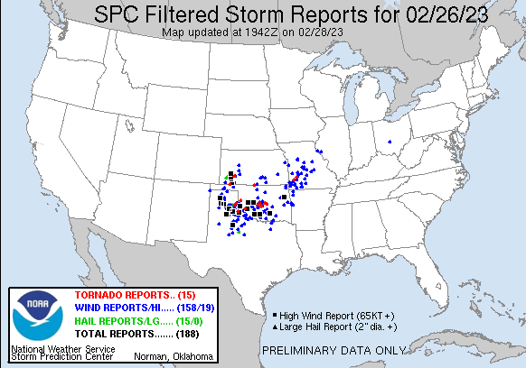
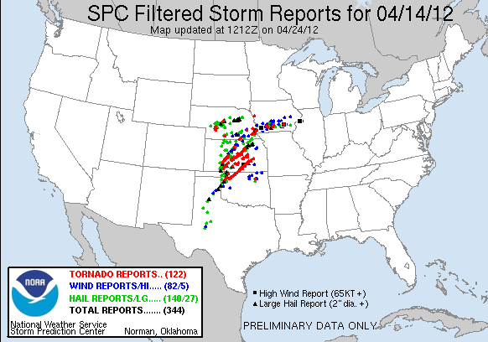
A
B
The point: parameters will only take you so far!
You need to know additional information about warm sector shape, residence time, storm mode, etc…
to successfully anticipate the outcomes.

Slide 8
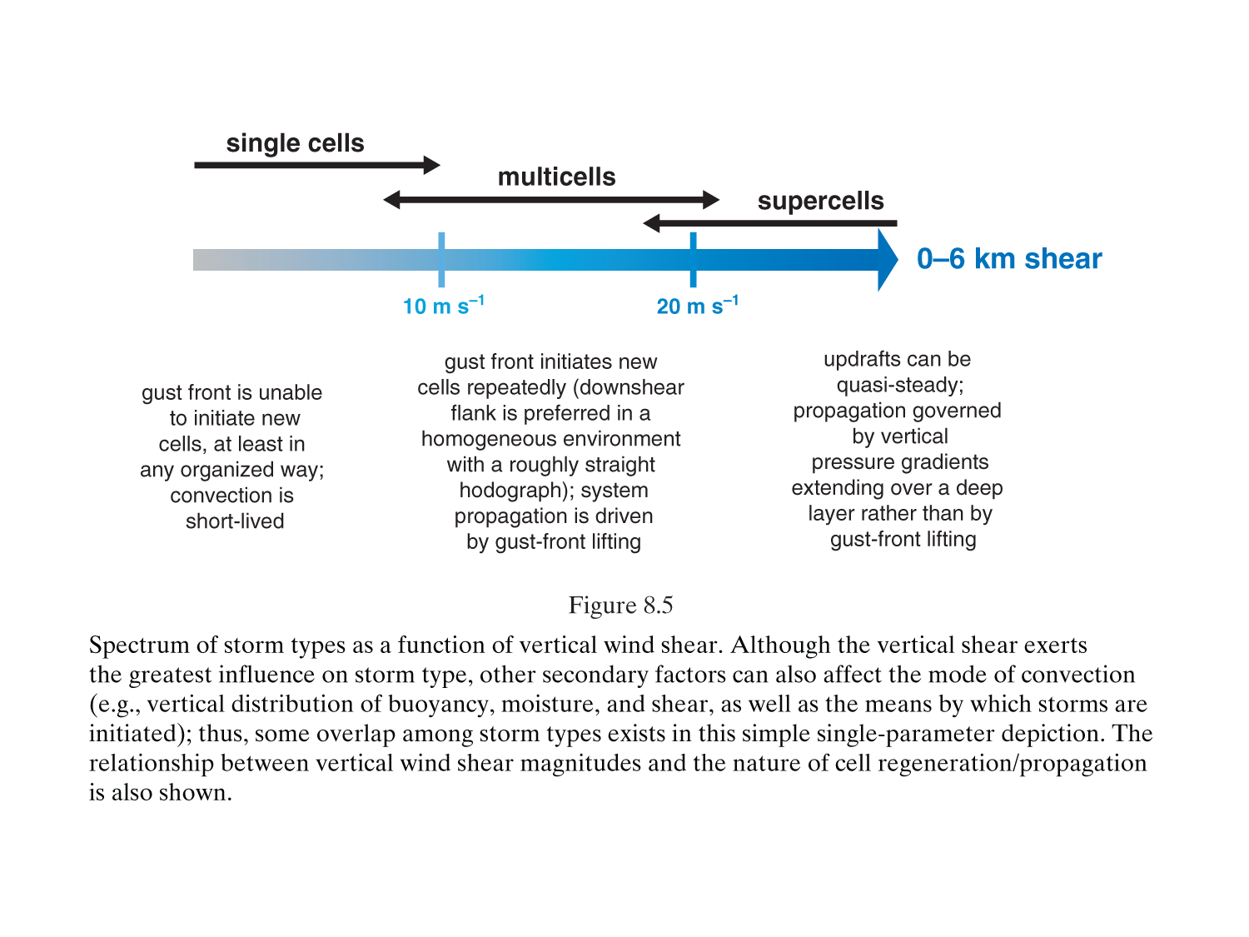
Importance of Vertical Shear
MR (2010)

Slide 9
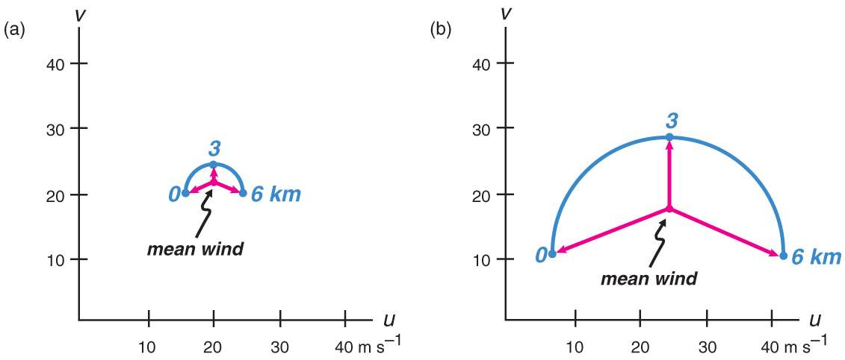
Importance of Vertical Shear
Interference between precipitation and updraft is reduced as vertical shear increases
Precipitation falls downwind of updraft
Strong storm-relative winds aloft blows precipitation away from updraft core
Storm-relative inflow at low-levels can slow speed of gust front, limiting its ability to undercut updraft
Weak shear
Strong shear
Dynamic pressure effects via vertical PGF in shear can produce strong lifting
MR (2010), Fig. 8.2

Slide 10
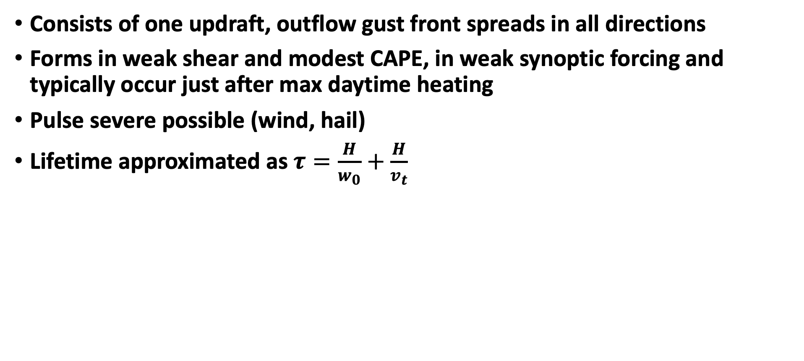
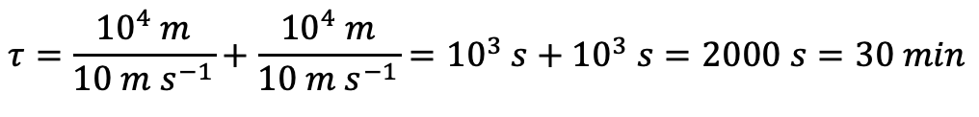
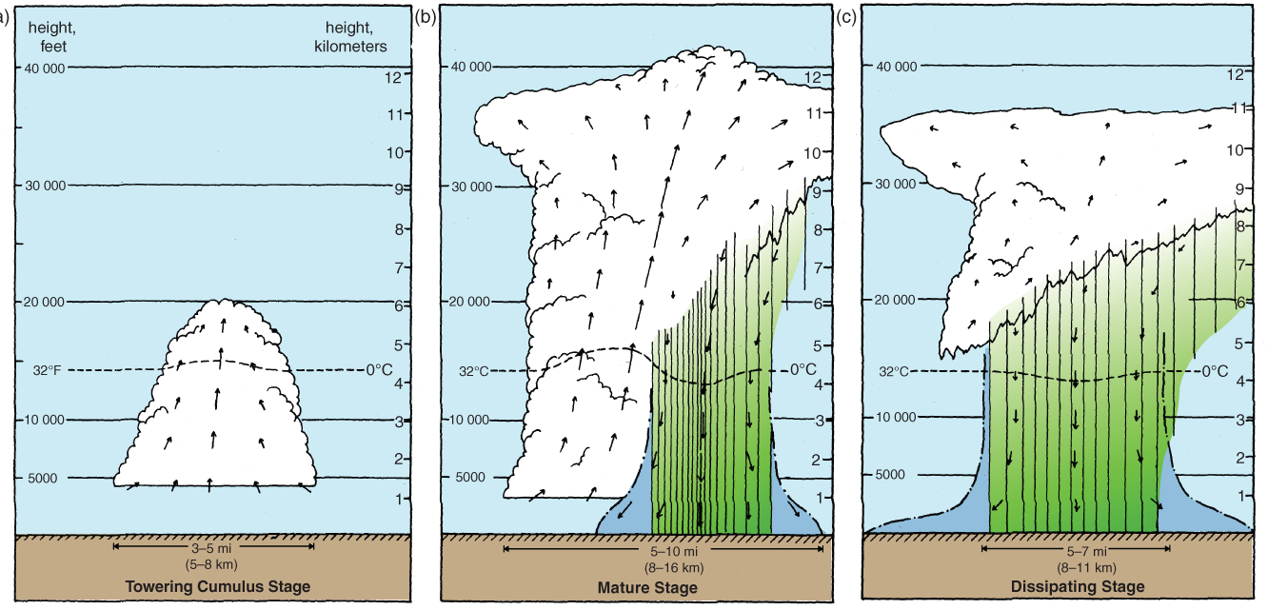
Ordinary Thunderstorm (single cell)
H=scale height
w₀=average updraft speed
v_{t}=terminal velocity of precipitation
Life cycle:
Towering cumulus (only updraft)
Mature (precipitation falls into updraft, downdraft and gust front forms, anvil forms)
Dissipating stage (downdraft cuts off updraft; orphan anvil)
MR (2010), Fig. 8.8

Slide 11
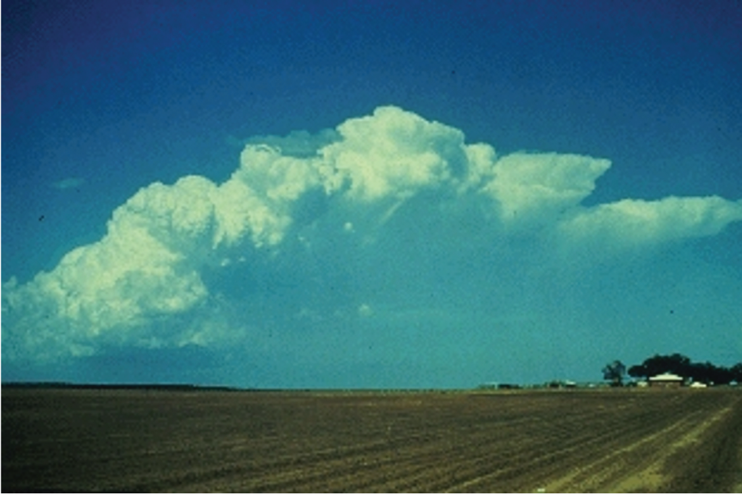
Multicell Convection
Characterized by repeated development of new cells along the gust front
Longer-lived cluster of storms in moderate vertical shear and small to large CAPE
Individual storms in cluster may be ordinary, lasting 30-60 mins
In high CAPE moderate shear, multicell convection can produce swaths of damaging winds and hail
Cell 3
Cell 4
Cell 2
Cell 5
Cell 1
MR (2010), Fig. 8.9

Slide 12
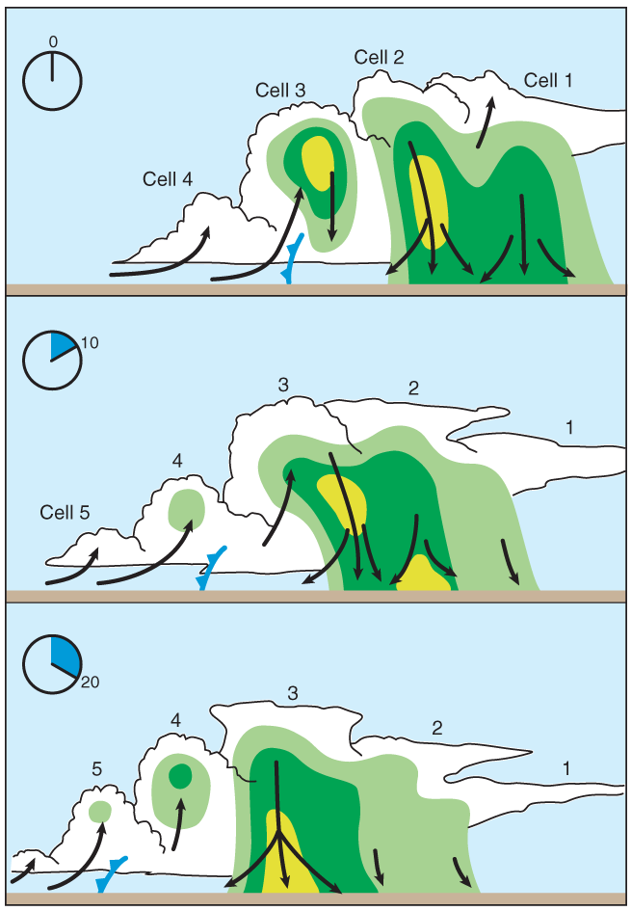
Evolution of Multicell Convection
Mean wind=0
Individual cells move with the mean wind averaged over their depth
New cells initiate along gust front
@ Time 0:
Cell 1 – dissipative stage
Cell 2 – mature stage
Cell 3 – precipitation beginning to form
Cell 4 – towering cumulus stage
@ Time 10:
Cell 1 – orphan anvil
Cell 2 – dissipative stage
Cell 3 – mature stage
Cell 4 – precipitation beginning to form
Cell 5 – towering cumulus stage
@ Time 20: …and so on.
propagation
MR (2010), Fig. 8.11

Slide 13
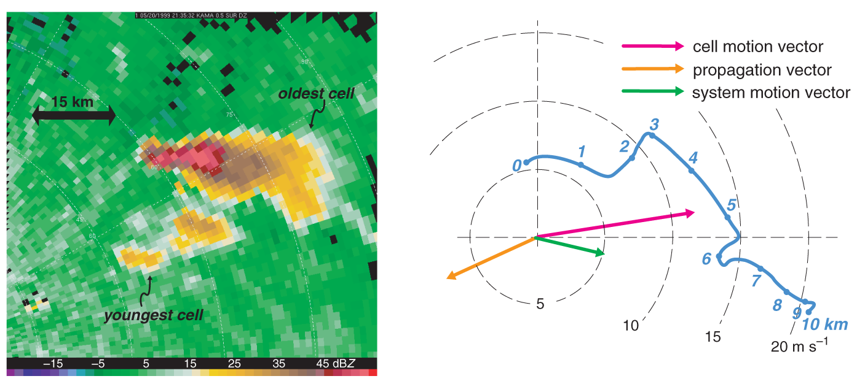
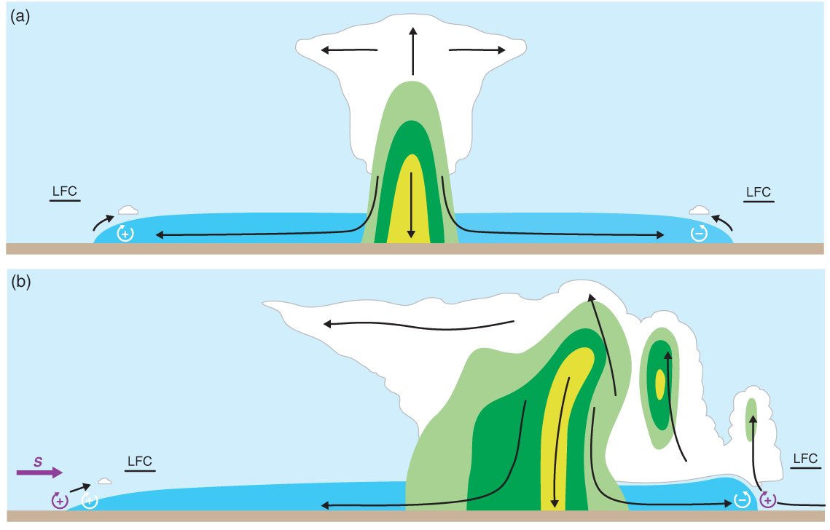
Movement versus propagation
Individual cells move with the mean wind
Repeated development of new cells on flank of system leads to propagation of system
Total motion is cell motion+propagation
New cells develop on gust front on downshear side of cold pool
Will cover more of this with MCS motion later
MR (2010), Fig. 8.10
Shear vector
MR (2010), Fig. 8.12

Slide 14
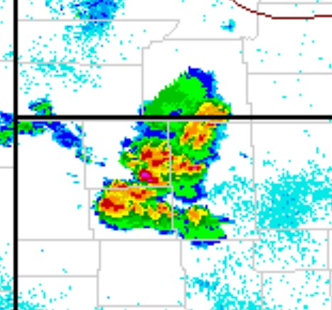
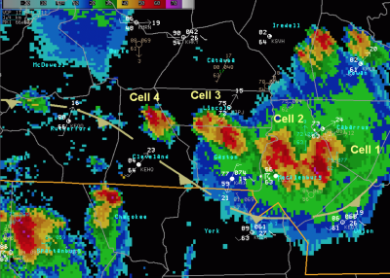
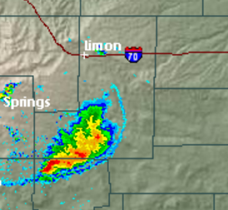
Multi Cell Clusters
Aggregates of multi-cell storms are common over parts of the Southeast in the summer. Each storm can be in a different phase of the life cycle.
Can act as a loosely organized MCS or as vague as a large convective blob.
Forcing is usually weak and the primary risk is damaging outflow winds from collapsing storms but can also produce hail.

Slide 15
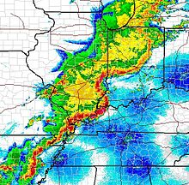
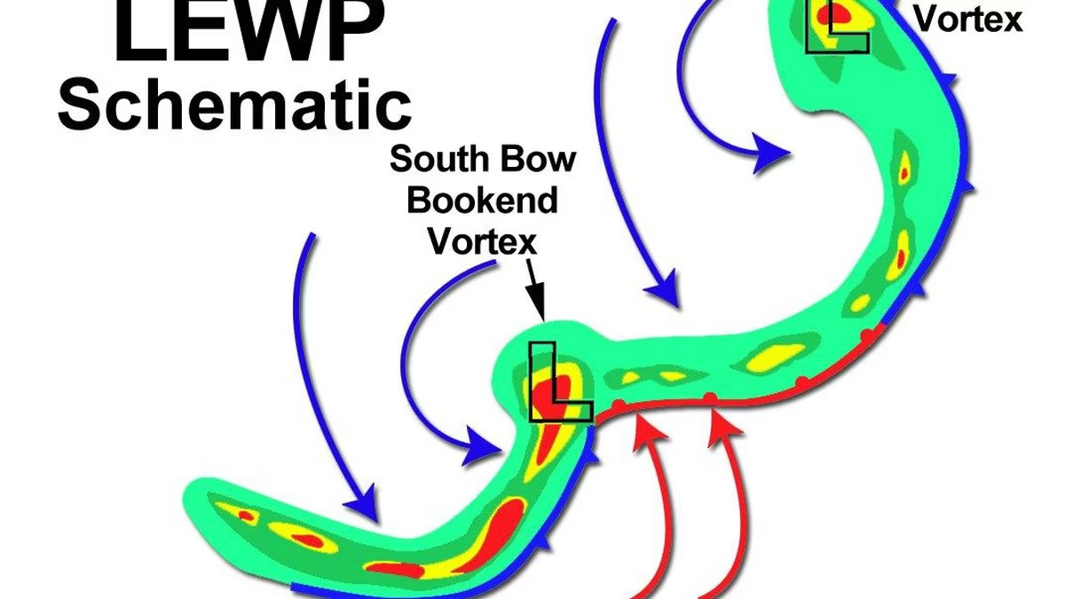
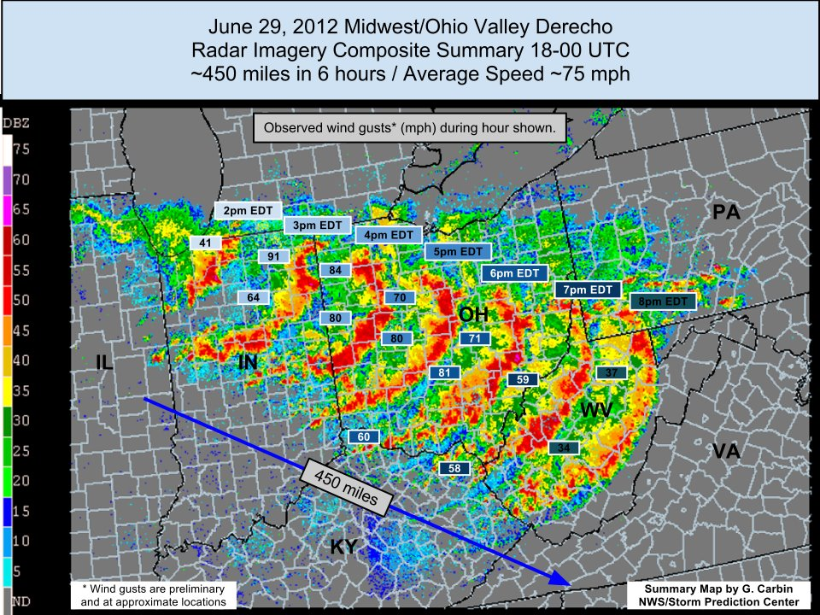
Squall Lines/Mesoscale Convective Systems (MCS)
Storm self-propagation dominated by cold pool driven ascent.
Can take multiple forms
Serial MCS
Progressive MCS
LEWPs (line echo wave patterns)
Bow echos
Derechos
Usually more organized than clusters with stronger vertical shear.
Can produce Damaging wind gusts tornadoes and some hail.

Slide 16
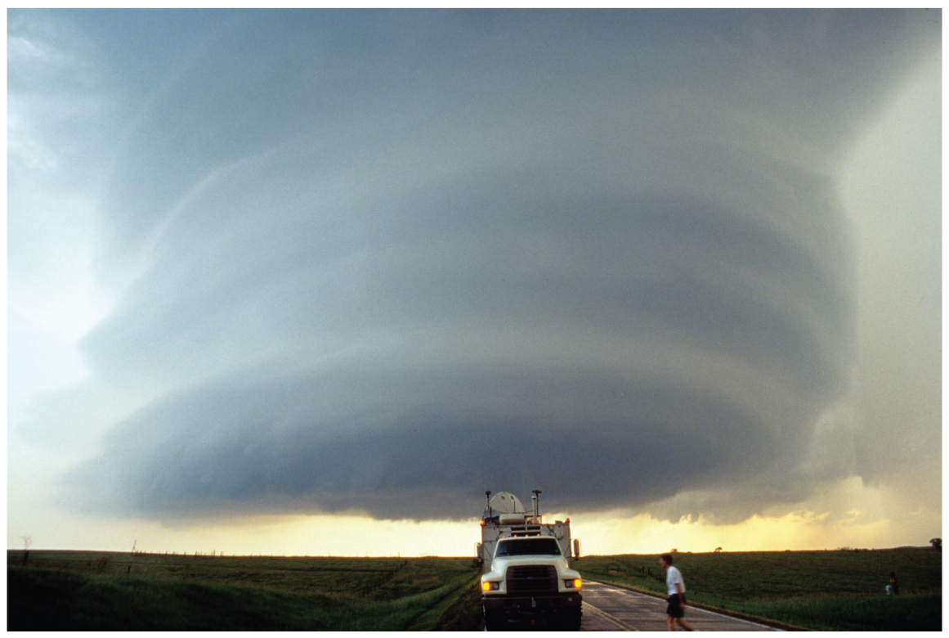
Supercells
Characterized by a thunderstorm with a sustained, deep, rotating updraft 🡪 mesocyclone
Occur in strong vertical shear through a deep layer (big storm-relative winds), but high CAPE not necessary
Motion deviates significantly from mean wind
Vertical PGF enhances updraft, a special property of supercells
MR (2010), Fig. 8.17

Slide 17
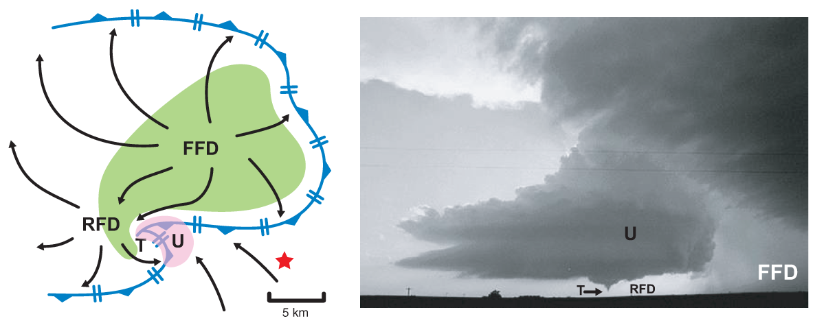
Supercell Features
Single, long-lived, quasi-steady, rotating, precipitation free, updraft
Wall cloud at updraft base where humid, rain-cooled air drawn upward
Two downdraft regions: rear flank downdraft (RFD) and forward flank downdraft (FFD)
MR (2010), Fig. 8.22

Slide 18
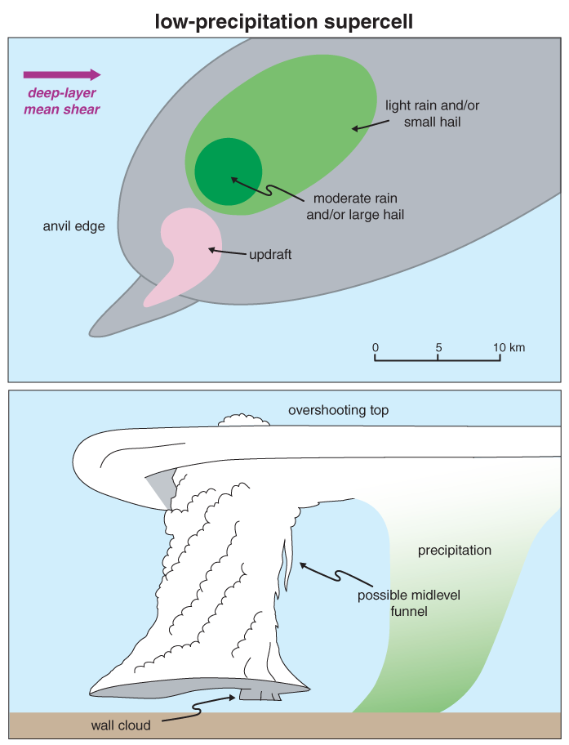
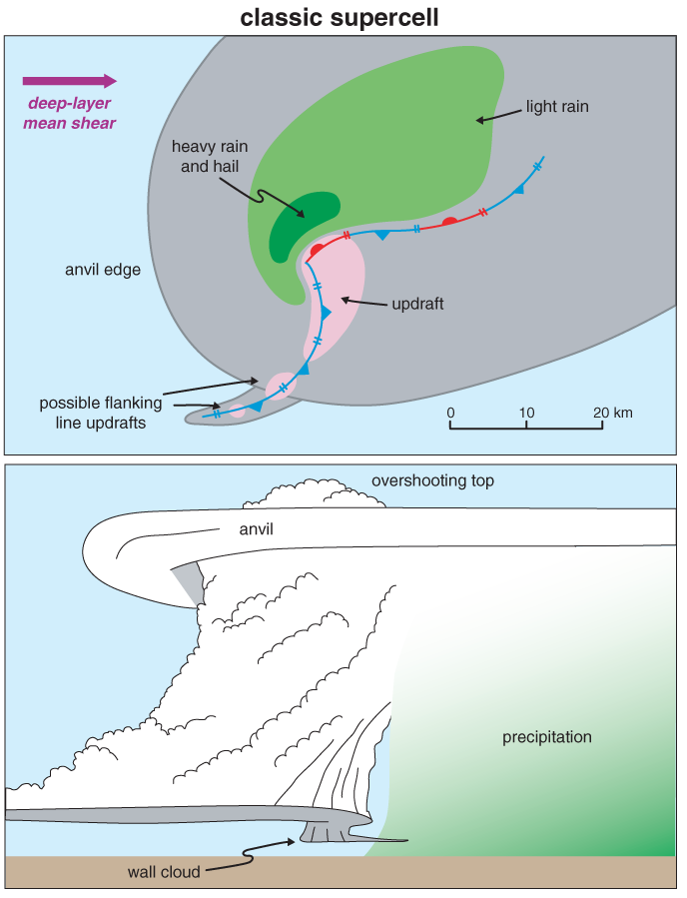
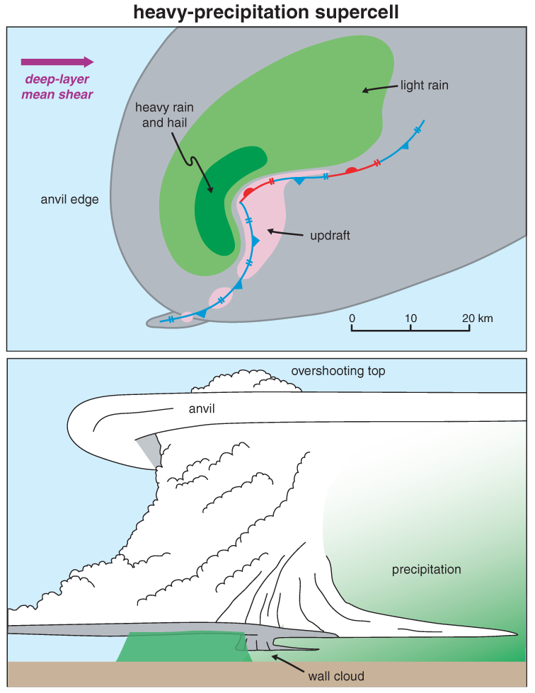
Supercell Types
For isolated storms, supercell type is (maybe) a function of storm-relative winds (SRW) at level of anvil (9–12 km AGL)
Weak upper-level storm-relative winds (<18 m/s): HP; moderate (18-28 m/s): classic; strong (>28 m/s): LP
For multiple storms in close proximity, precipitation from one storm may seed another storm, favoring HP types
Stronger SRW favors larger updrafts resistant to entrainment.
MR (2010), Fig. 8.24
MR (2010), Fig. 8.16
MR (2010), Fig. 8.26

Slide 19
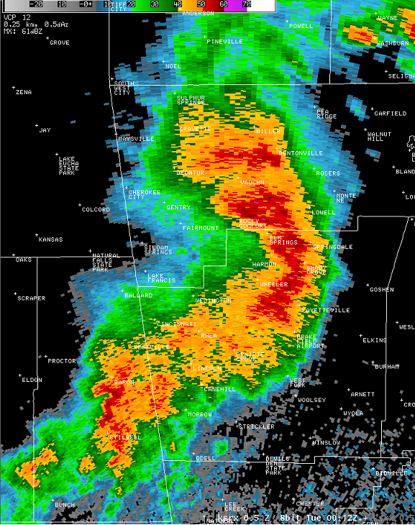
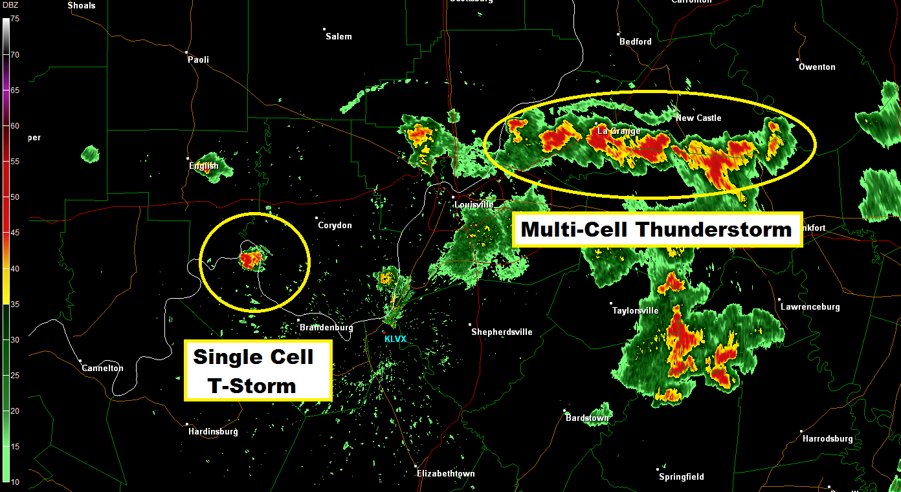
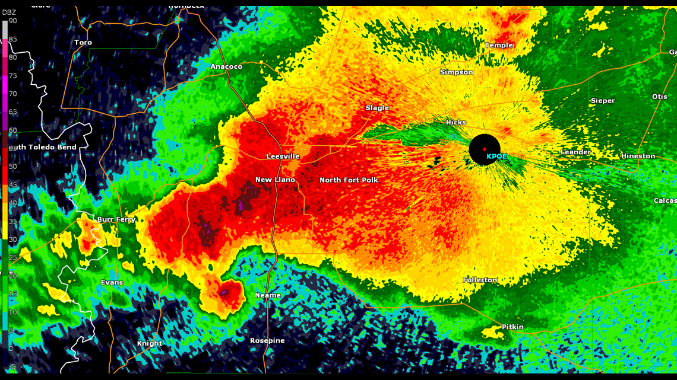
Storm Mode Spectrum
How do we anticipate the storm mode?

Slide 20
Storm Mode Basics
All of these must be taken into account to anticipate storm mode for the first few hours after convective initiation.
Consider each of these:
Boundary-relative storm motion
Boundary-relative deep-layer shear
Storm-relative anvil-level winds
Strength of forcing for ascent
Strength of capping
Numerous combinations are possible!

Slide 21
Storm Mode Basics
Boundary = zone of ascent
Boundary Motion (B) = (0,0)
Consider each of these:
Boundary-relative storm motion
Boundary-relative deep-layer shear
Storm-relative anvil-level winds
Strength of forcing for ascent
Strength of capping
U components
V components
storm motion (c) = (20,0)
Boundary-relative storm motion (Cb) = c - B
Cb = ((20- 0), (0 - 0))
Cb = (20,0)
Result: Storm moves off boundary;
favorable for discrete convection!

Slide 22
Storm Mode Basics
Boundary = zone of ascent
Boundary Motion (B) = (20,0)
Consider each of these:
Boundary-relative storm motion
Boundary-relative deep-layer shear
Storm-relative anvil-level winds
Strength of forcing for ascent
Strength of capping
storm motion (c) = (20,0)
Boundary-relative storm motion (Cb) = c - B
Cb = ((20- 20), (0 - 0))
Cb = (0,0)
Result: Storm remains on boundary;
Enhances residence time, promotes upscale growth!

Slide 23
Storm Mode Basics
Boundary = zone of ascent
Boundary Motion (B) = (20,20)
Consider each of these:
Boundary-relative storm motion
Boundary-relative deep-layer shear
Storm-relative anvil-level winds
Strength of forcing for ascent
Strength of capping
storm motion (c) = (10,10)
Boundary-relative storm motion (Cb) = c - B
Cb = ((10- 20), (10 - 20))
Cb = (-10,-10)
Result: Storm motion behind boundary;
Enhances residence time, promotes upscale growth!

Slide 24
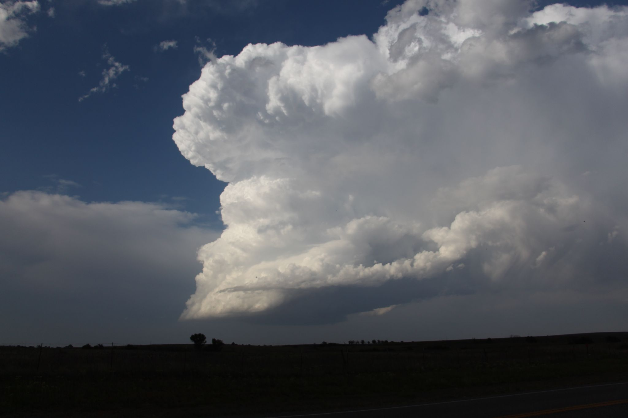
Storm Mode Basics
Downshear Pressure Perturbation
Effective BWD Vector
Consider each of these:
Boundary-relative storm motion
Boundary-relative deep-layer shear
Storm-relative anvil-level winds
Strength of forcing for ascent
Strength of capping
Convergence
(high pressure perturbation)
Divergence
(low pressure perturbation)

Slide 25
Storm Mode Basics
Downshear Pressure Perturbation
Effective BWD Vector
Consider each of these:
Boundary-relative storm motion
Boundary-relative deep-layer shear
Storm-relative anvil-level winds
Strength of forcing for ascent
Strength of capping
Convergence
(high pressure perturbation)
Divergence
(low pressure perturbation)
Induced
subsidence
Induced
ascent

Slide 26
Storm Mode Basics
Off Boundary
Effective BWD Vector
Consider each of these:
Boundary-relative storm motion
Boundary-relative deep-layer shear
Storm-relative anvil-level winds
Strength of forcing for ascent
Strength of capping
The deep-layer shear vector orients the precipitation distribution away from the updraft (ex: size sorting)
Off-boundary deep-layer shear vectors favor precipitation distributions away from neighboring cells
Also favors downshear updraft development into warm sector, which favors discrete cells.

Slide 27
Storm Mode Basics
Along Boundary
Effective BWD Vector
Consider each of these:
Boundary-relative storm motion
Boundary-relative deep-layer shear
Storm-relative anvil-level winds
Strength of forcing for ascent
Strength of capping
Deep-layer shear vectors along the boundary favor precipitation (and outflow/cold pool) distributions towards the updraft regions of neighboring storms.
Also favors downshear updraft development in close proximity to neighboring storms.
This tends to favor cold pool amalgamation and upscale growth.

Slide 28
Storm Mode Basics
Anvil-level SR wind
Consider each of these:
Boundary-relative storm motion
Boundary-relative deep-layer shear
Storm-relative anvil-level winds
Strength of forcing for ascent
Strength of capping
The anvil-level storm relative (SR) winds influence storm morphology similar to the deep-layer shear vector.
They influence downstream anvil shading and seeding of new updrafts from fallout hydrometeors
Z
Y
Storm motion
X

Slide 29
Storm Mode Basics
Along Boundary
Consider each of these:
Boundary-relative storm motion
Boundary-relative deep-layer shear
Storm-relative anvil-level winds
Strength of forcing for ascent
Strength of capping
Anvil-level SR wind
Along-boundary anvil-level SR winds tend to seed new updrafts in close proximity to neighboring storms.
This tends to favor upscale growth
Z
Y
Storm motion
X

Slide 30
Storm Mode Basics
Off Boundary
Consider each of these:
Boundary-relative storm motion
Boundary-relative deep-layer shear
Storm-relative anvil-level winds
Strength of forcing for ascent
Strength of capping
Anvil-level SR wind
Off-boundary anvil-level SR winds tend to seed new updrafts downstream into the warm sector.
This tends to favor discrete cells.
Z
Y
Storm motion
X

Slide 31
Storm Mode Basics
No Lift?
Consider each of these:
Boundary-relative storm motion
Boundary-relative deep-layer shear
Storm-relative anvil-level winds
Strength of forcing for ascent
Strength of capping
No storms!

Slide 32
Storm Mode Basics
Weak Ascent
Consider each of these:
Boundary-relative storm motion
Boundary-relative deep-layer shear
Storm-relative anvil-level winds
Strength of forcing for ascent
Strength of capping
Fewer initial cells, greater spacing between cells, less chance of storm interactions
(even if shear/anvil-level winds aren’t favorable)
This tends to favor discrete cells.
Weak forcing mechanisms:
Drylines
Weak outflow boundaries
Confluence axes

Slide 33
Storm Mode Basics
Strong Ascent
Consider each of these:
Boundary-relative storm motion
Boundary-relative deep-layer shear
Storm-relative anvil-level winds
Strength of forcing for ascent
Strength of capping
More initial cells, smaller spacing between cells, higher chance of storm interactions
(even if boundary-relative storm motions are favorable for discrete)
This tends to favor upscale growth.
Strong forcing mechanisms:
Surging cold fronts
Strong outflow boundaries

Slide 34
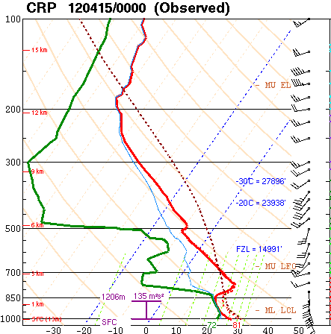
Storm Mode Basics
“Nuclear” cap?
Consider each of these:
Boundary-relative storm motion
Boundary-relative deep-layer shear
Storm-relative anvil-level winds
Strength of forcing for ascent
Strength of capping
No storms!

Slide 35
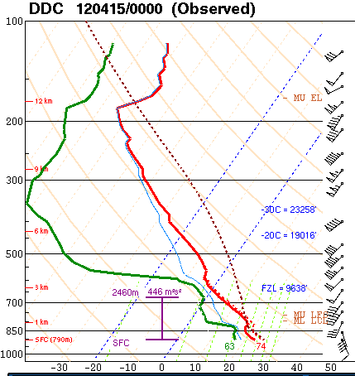
Storm Mode Basics
Weak cap?
Consider each of these:
Boundary-relative storm motion
Boundary-relative deep-layer shear
Storm-relative anvil-level winds
Strength of forcing for ascent
Strength of capping
Limits number of initial storms: favorable for discrete cells

Slide 36
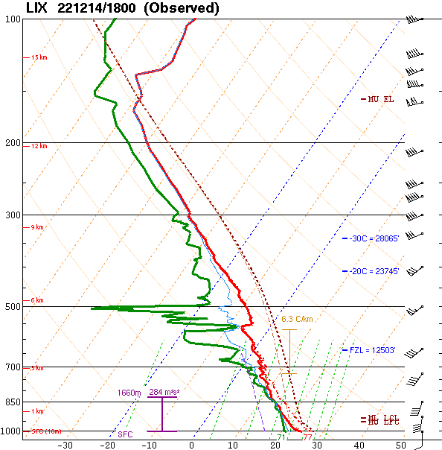
Storm Mode Basics
No cap?
Consider each of these:
Boundary-relative storm motion
Boundary-relative deep-layer shear
Storm-relative anvil-level winds
Strength of forcing for ascent
Strength of capping
Remember: numerous combinations are possible!
Allows for numerous storms, favors upscale growth

Slide 37
Storm Mode Basics
Consider each of these:
Boundary-relative storm motion
Boundary-relative deep-layer shear
Storm-relative anvil-level winds
Strength of forcing for ascent
Strength of capping
How do I weight each of these factors?

Slide 38
Storm Mode Basics
Consider each of these:
Strength of forcing for ascent
Boundary-relative storm motion
Boundary-relative deep-layer shear
Storm-relative anvil-level winds
Strength of capping
Primary influencing factor
Secondary influencing factors
Modulating factor

Slide 39
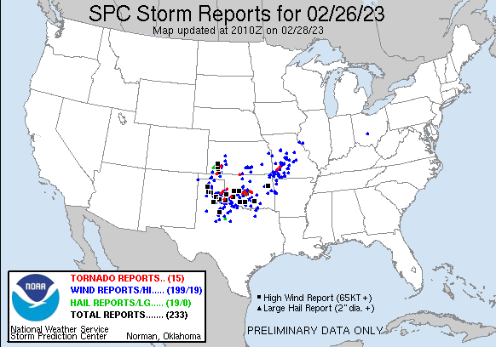
Storm Mode Basics:
Quick Example

Slide 40
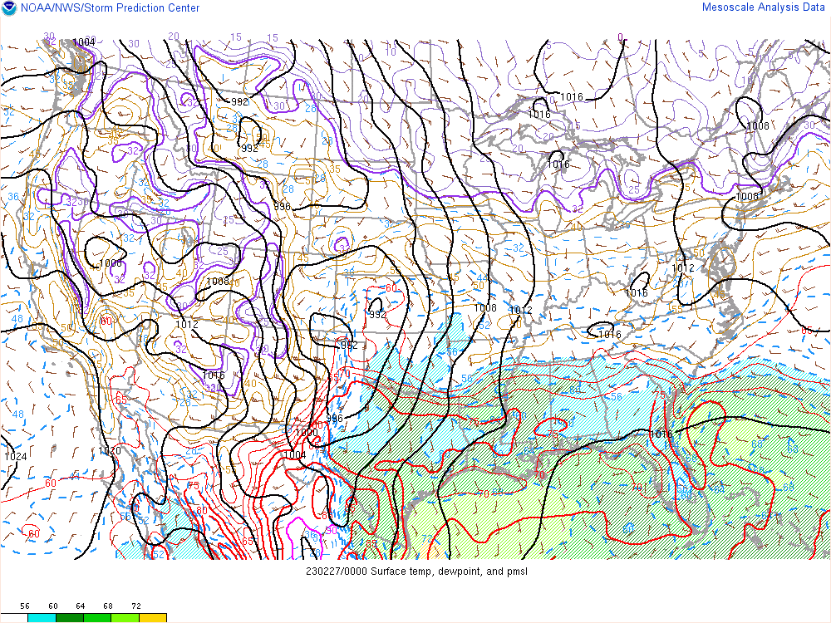
First, Identify the boundaries!

Slide 41
First, Identify the boundaries!

Slide 42
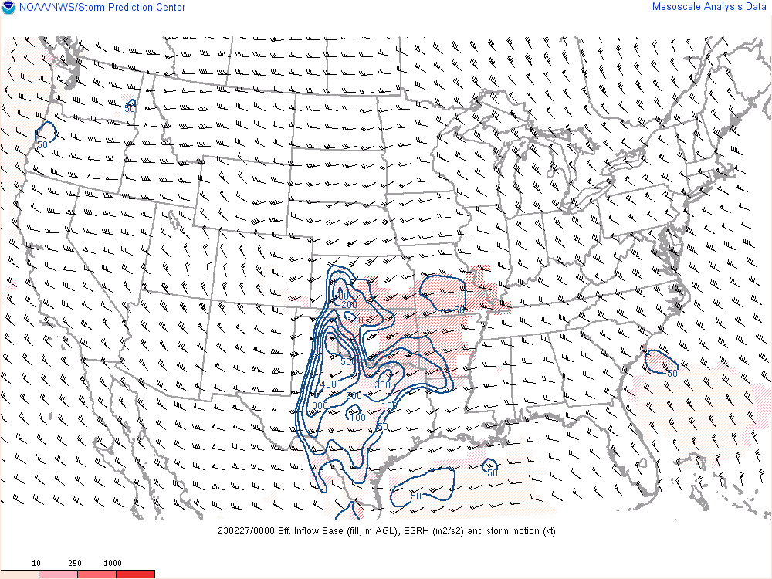
Bunker’s right-mover storm motion vectors off the dryline…
Favors discrete!

Slide 43
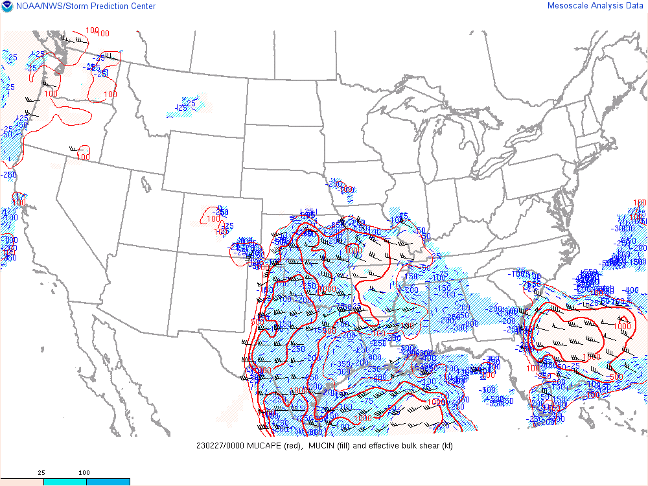
Effective shear orientation off the cold front/dryline…
-150 to -100 MUCIN…
Favors discrete!

Slide 44
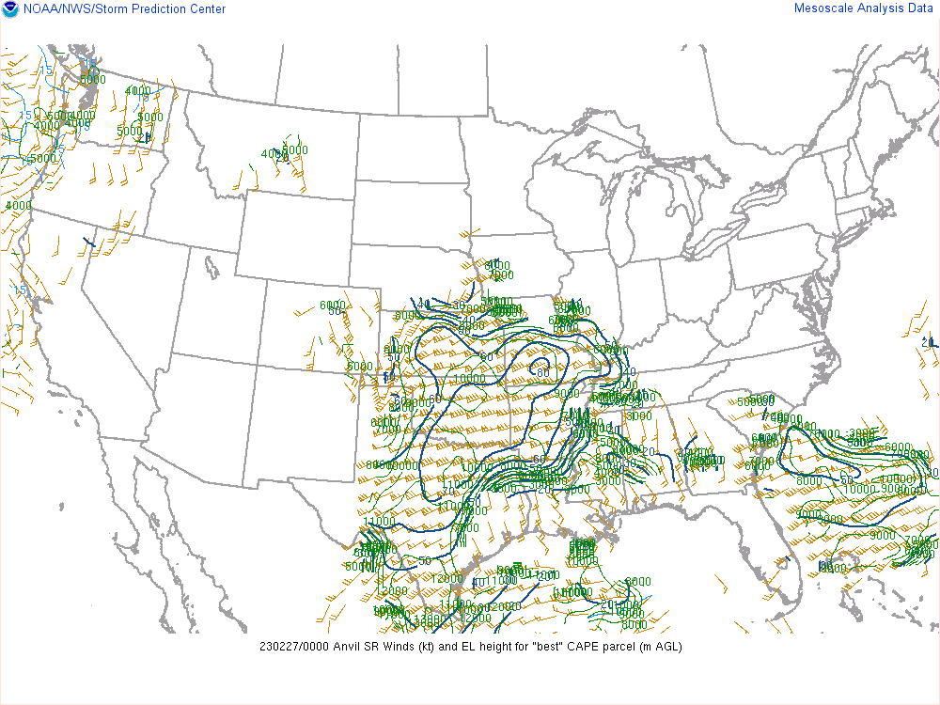
Anvil-level SR winds are off the cold front/dryline…
Favors discrete!

Slide 45
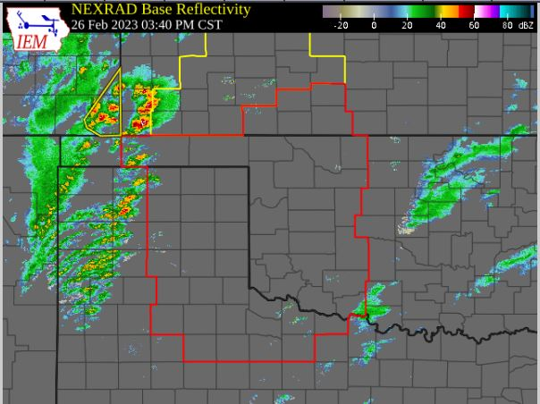
Initial cells developing along the dryline are discrete/semi-discrete!

Slide 46
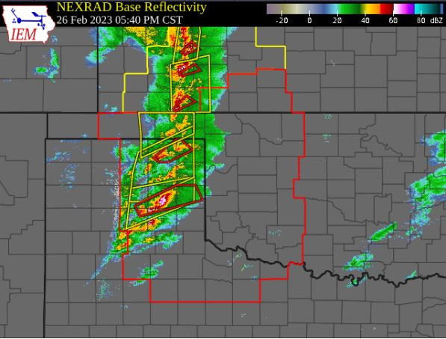
2 hours later… cells remain semi-discrete.
A few tornadoes and 1.5 inch hail are reported…

Slide 47
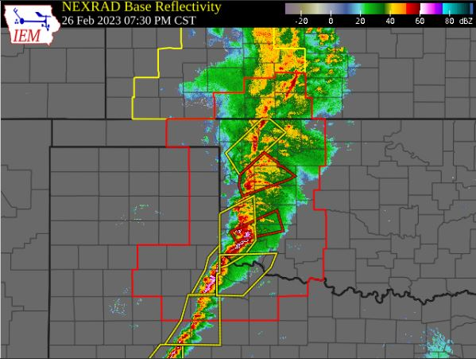
2 hours later…
Squall line with 75-114 mph winds reported.
What changed?

Slide 48
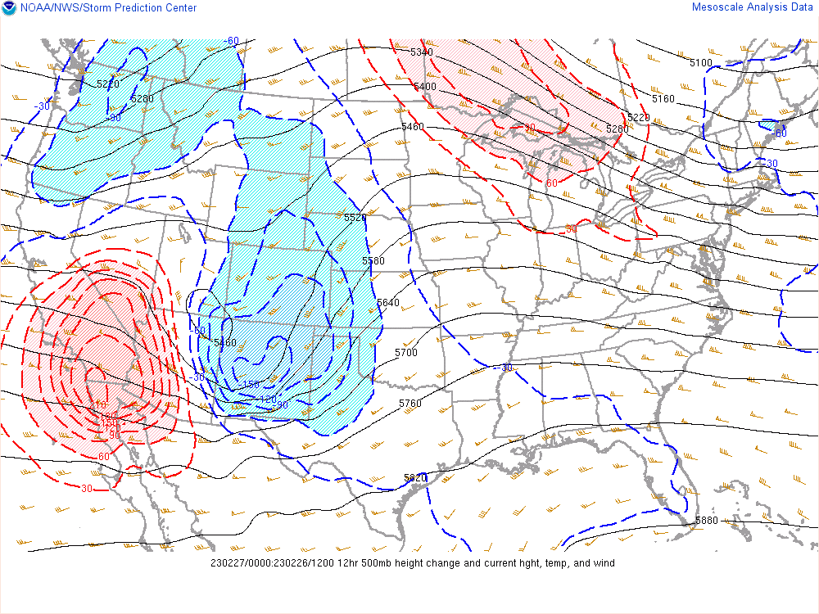
Very strong height falls aloft associated with
the approach of a robust upper wave.
Strong ascent associated with an eastward-moving Pacific cold front
Both of these factors yielded very strong lift along the front, resulting in rapid upscale growth.

Slide 49
Moral of the story: these techniques work, but you have to take the entire synoptic regime into account and anticipate changes in time.

Slide 50
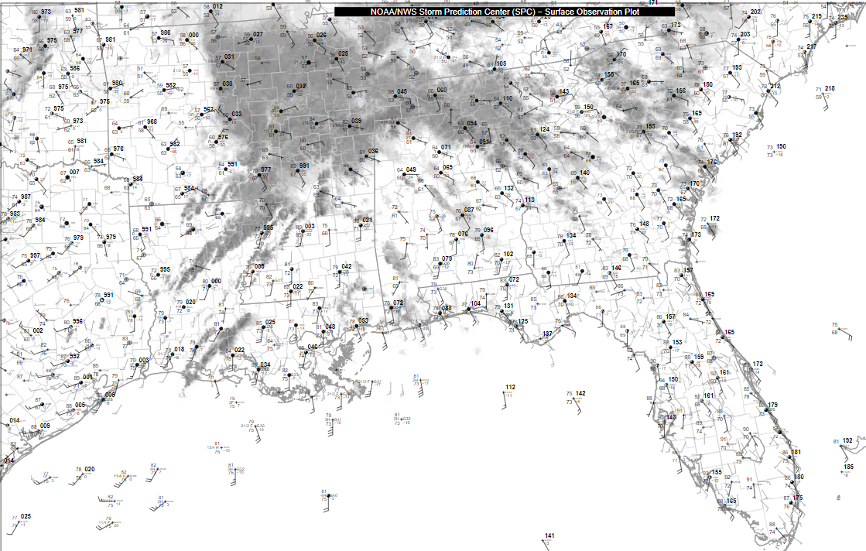
Where are the relevant boundaries?
How expansive is the warm sector?

Slide 51
L
L
65 F
70 F
Where are the relevant boundaries?
How expansive is the warm sector?
75 F

Slide 52
L
L
65 F
70 F
Here’s the warm sector!
But which boundary is most important?
75 F

Slide 53
L
Storm motion into the cooler air. No residence time in the surface-based warm sector.
L
65 F
70 F
Here’s the warm sector!
But which boundary is most important?
75 F

Slide 54
L
Storm initiates in warm sector, but has limited time/space to reside in the best thermo environment.
Implications for storm longevity/maturation?
L
65 F
70 F
Here’s the warm sector!
But which boundary is most important?
75 F

Slide 55
L
L
65 F
Storm initiates in warm sector, and will remain in the warm sector. But what is boundary-relative storm motion?
Implications for storm mode?
70 F
Here’s the warm sector!
But which boundary is most important?
75 F

Slide 56
L
L
65 F
Storm initiates in warm sector, and will remain in the warm sector. Initiating from this boundary will maximize residence time in the open warm sector!
Given the weak forcing for ascent with the boundary (confluence axis/surface trough) what are the implications for storm longevity and intensity?
70 F
Here’s the warm sector!
But which boundary is most important?
75 F

Slide 57
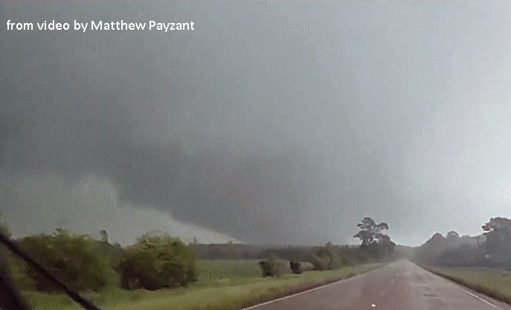
L
L
65 F
70 F
04/12/2020 18 UTC sfc obs
Multiple EF-3+ tornadoes hours later
Here’s the warm sector!
But which boundary is most important?
75 F

Slide 58
L
L
65 F
70 F
Is this region in the clear?
75 F

Slide 59
L
L
65 F
70 F
Consider an evolving warm sector!
75 F

Slide 60
L
L
65 F
70 F
18 UTC
75 F

Slide 61
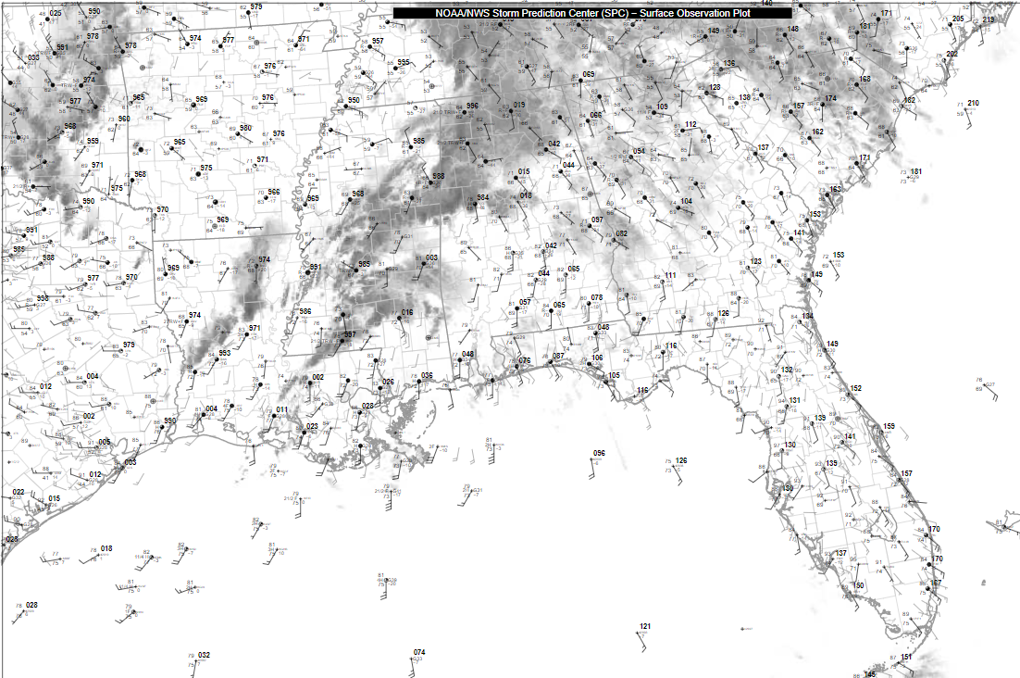
Warm Sector Geometry and Residence Time
L
L
65 F
70 F
75 F
21 UTC
75 F

Slide 62
Warm Sector Geometry and Residence Time
L
L
65 F
70 F
Note the diffuse warm frontal zone
Warm sector is expanding northeast with the deepening surface low.
75 F
21 UTC
75 F

Slide 63
Warm Sector Geometry and Residence Time
L
L
65 F
70 F
What does this mean for a cell developing on the outflow boundary?
Will it have long warm-sector residence time?
75 F
21 UTC
75 F

Slide 64
L
L
65 F
70 F
Consider the speed and direction in which the warm sector and low are moving.
75 F
21 UTC
75 F

Slide 65
L
L
65 F
70 F
This warm sector geometry and evolution will favor long residence times for new cells.
This implies an increasing severe risk for northern AL and northwest GA
(assuming favorable thermo + kinematic environment)
75 F
21 UTC
75 F

Slide 66
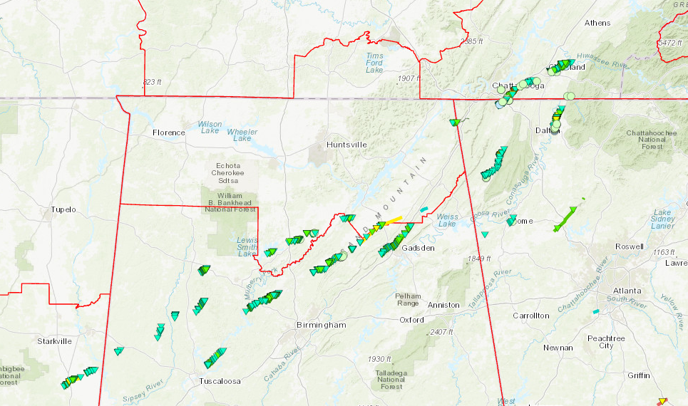
Warm Sector Geometry and Residence Time
04/12/2020 Tornado Outbreak

Slide 67
Warm Sector Geometry and Residence Time Summary
Careful surface analysis will help identify important features and warm sector geometry.
Utilize observed and/or forecast storm motions and warm sector evolution to gauge whether or not a storm will:
Quickly become displace out of the warm sector
Have a short residence time
Have a long residence time
Longer residence times favor storm maturation, which implies a higher potential for impactful weather

Slide 68

Storm Interactions: Good or Bad?
It’s not always clear!

Slide 69
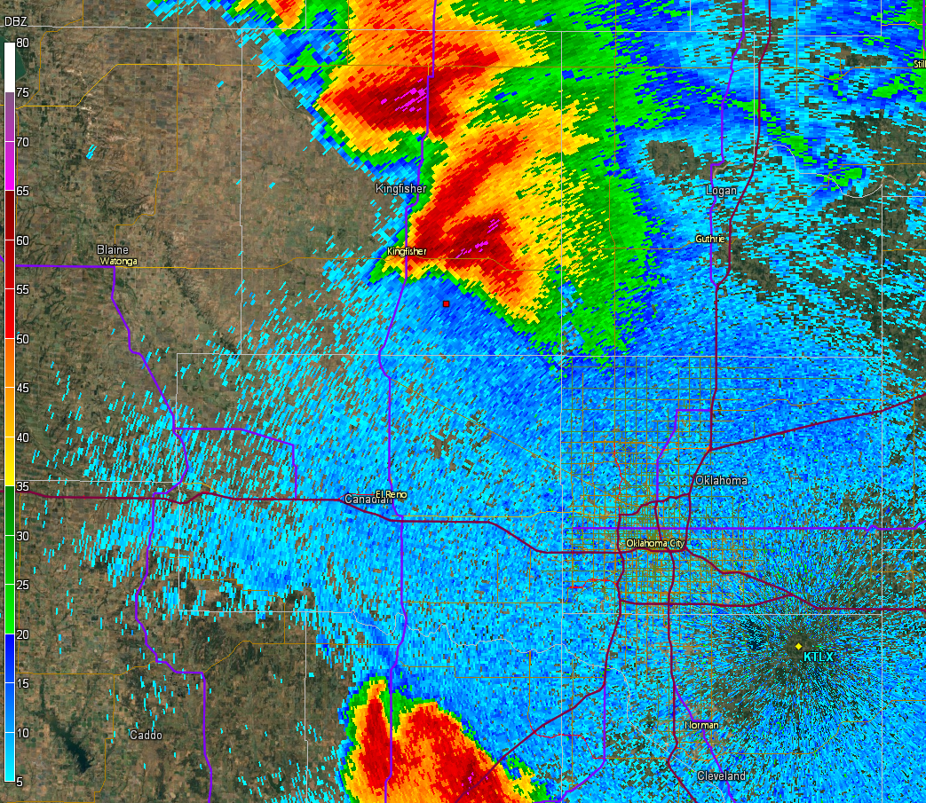
Estimated RM 328 @ 11 kt
Observed RM 336 @ 15 kt
Estimated LM 231 @ 26 kt
Observed LM 230 @ 29 kt
0040Z

Slide 70

Outflow with left mover
0050Z

Slide 71

0059Z

Slide 72

0108Z

Slide 73

0117Z

Slide 74

Brief tornado after
outflow interaction
0131Z

Slide 75

Tornado is gone, but lots of hail impacting the northern OKC metro
0140Z

Slide 76


Slide 77


Slide 78

Outflow undercutting updraft?

Slide 79

New cell developing

Slide 80


Slide 81


Slide 82


Slide 83


Mesocyclone intensifies and
produces tornado
Photo by Silver Lining Tours

Slide 84
Storm Interactions: Good or Bad?
I don’t know, I see a positive trend here!

Slide 85

2214Z

Slide 86

2222Z

Slide 87

Damaging tornadoes
Remnant left mover
2231Z

Slide 88

Outflow interacts with southern storm, which rains into inflow of northern storm
2239Z

Slide 89

2248Z

Slide 90

Both storms weaken – northern tornado dissipated, southern tornado weakening
2300Z

Slide 91


Slide 92


Slide 93


Slide 94


Slide 95


Slide 96

INTENSE TORNADO ONGOING
Issue a Tornado Emergency
for western OKC metro?

Slide 97


Slide 98

Continuous cell development on triple point

Slide 99

Onset of a deadly flash flood event in OKC
(panic induced?)

Slide 100

Storm Interactions: What does the literature say?
Flournoy et al. 2020 looked at 120+ instances of
supercell mergers.
Found that there is no strong trend for constructive or destructive mergers.
This is consistent with
previous studies.
Summary: It’s not always clear!
Figure 10 from Flournoy et al. 2020

Slide 101

Storm Interactions: What does the literature say?
Flournoy et al. 2020 looked at 120+ instances of
supercell mergers.
Did find some evidence that strong cells weaken and weak cells strengthen after mergers.
However, knowing which will occur will require a full environmental analysis!
Figure 11 from Flournoy et al. 2020

Slide 102
Quick Recap
Storm Mode
All very important for anticipating the correct hazards!
Storm Interactions
Linear Extrapolation
Warm Sector Geometry

